Slide 1

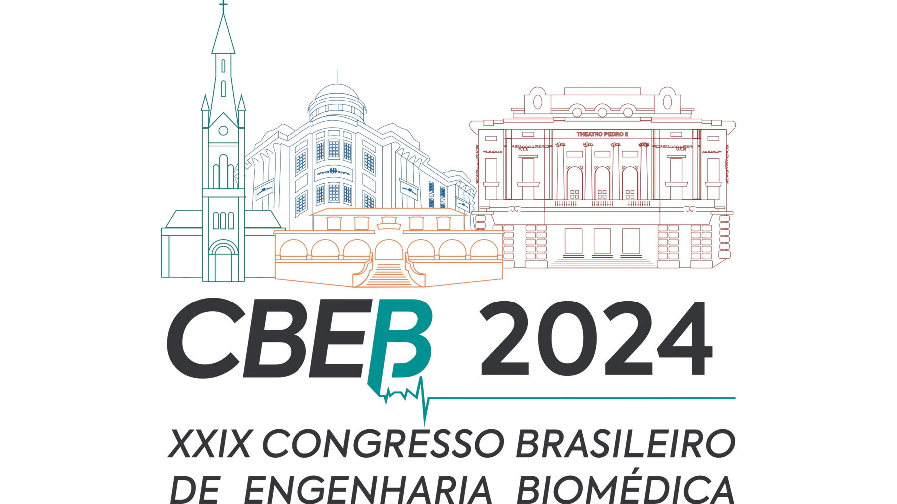


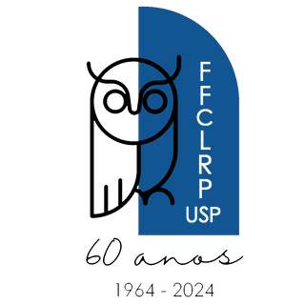

Universidade Federal do ABC
Biomedical Engineering, CECS, Federal University of ABC, São Paulo, Brazil
Development of a Visible Light Tomograph for Teaching Computed Tomography Concepts in Undergraduate Medical Physics Classrooms
Desenvolvimento de um tomógrafo de luz visível para o ensino de conceitos de Tomografia Computadorizada em salas de aula de graduação em física médica
I. K. F. Stein, B. Murakami and J. A. Sims
Realização

Slide 2

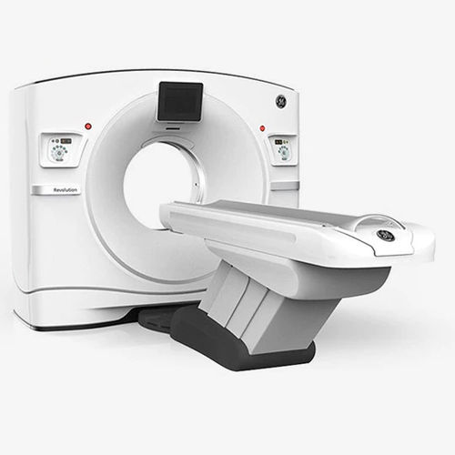



Motivation
In engineering education there is a lack of teaching resources that are close to practice
Application of teaching equipment in education
High cost equipment
Ionizing radiation
Large size
Raio-x, CT, NM
Design thinking
Hands-on
Do it Yourself
Problem-based learning

Slide 3






Motivation
About the theoretical explanation of CT in the subject of Medical Physics I:
About the difficulty in understanding CT concepts:
We conducted a survey with Biomedical Engineering students at UFABC, where 20 responses were obtained
75%
25%
Easily understood
Had difficulty
About understanding CT subjects:
14 students
4 former students
2 professors
100% students
They believe that if they had closer contact with teaching equipment they would understand the topic better

Slide 4

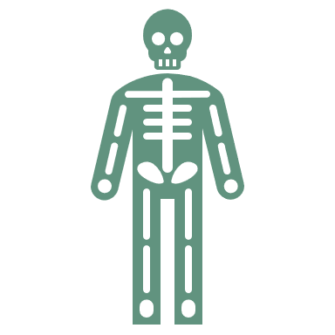





Objectives
Understand the need for didactic equipment to explain the principles of CT
Develop a didactic prototype of CT equipment using safe radiation (visible light), capable of acquiring images of 3D objects in multiple projections, which will assist in teaching the main concepts of CT
Develop software to assist in teaching the principles of TR, i.e. reconstruct an object’s 3D volume from a set of multiple projections

Slide 5
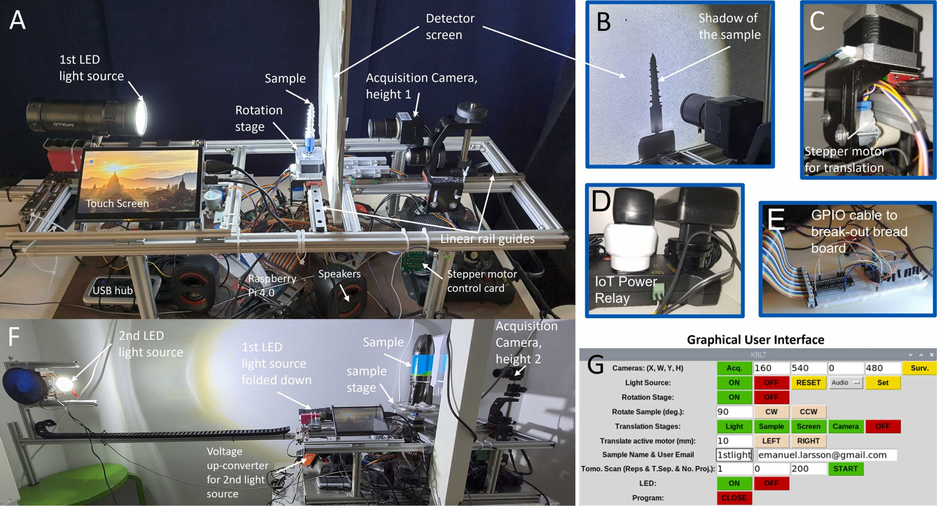
Estado da Arte
Kitchen based light tomograph (KBLT)
Larsson et al. (2023)

Slide 6

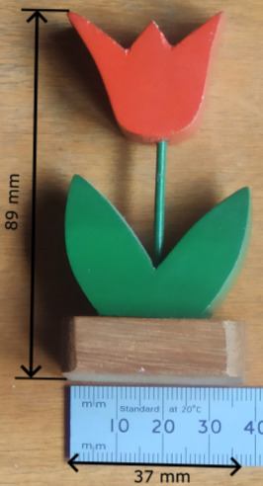
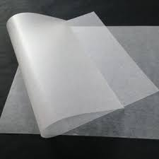

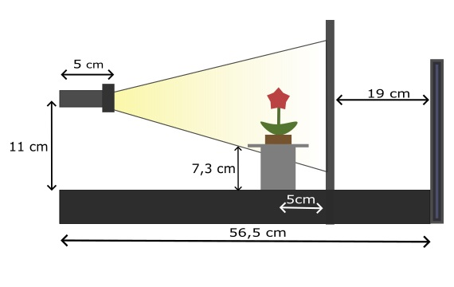
Methodology
Object
Baking paper
Smartphone
Materials
3D printer (3D Core A3 GTMAX3D-PRO).
Software by Google (Mountain View, CA) Colab;
Python 3 e standard scientific libraries including simple ITK;
Slicer 3D (Surgical Planning Lab, Boston, MA) v5.6.1;
Blender (Blender Foundation, Amsterdã, Holanda) v4.1.1;
Simplify 3D v.1.2 to generate gcode from .stl.
Visible light
source

Slide 7
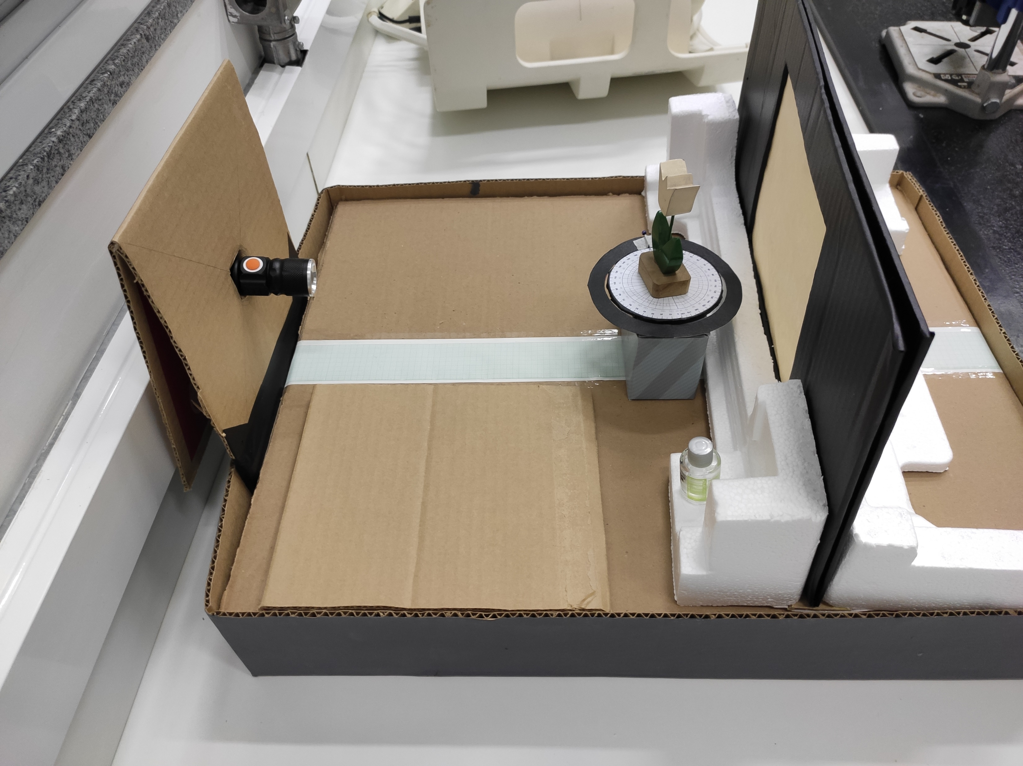
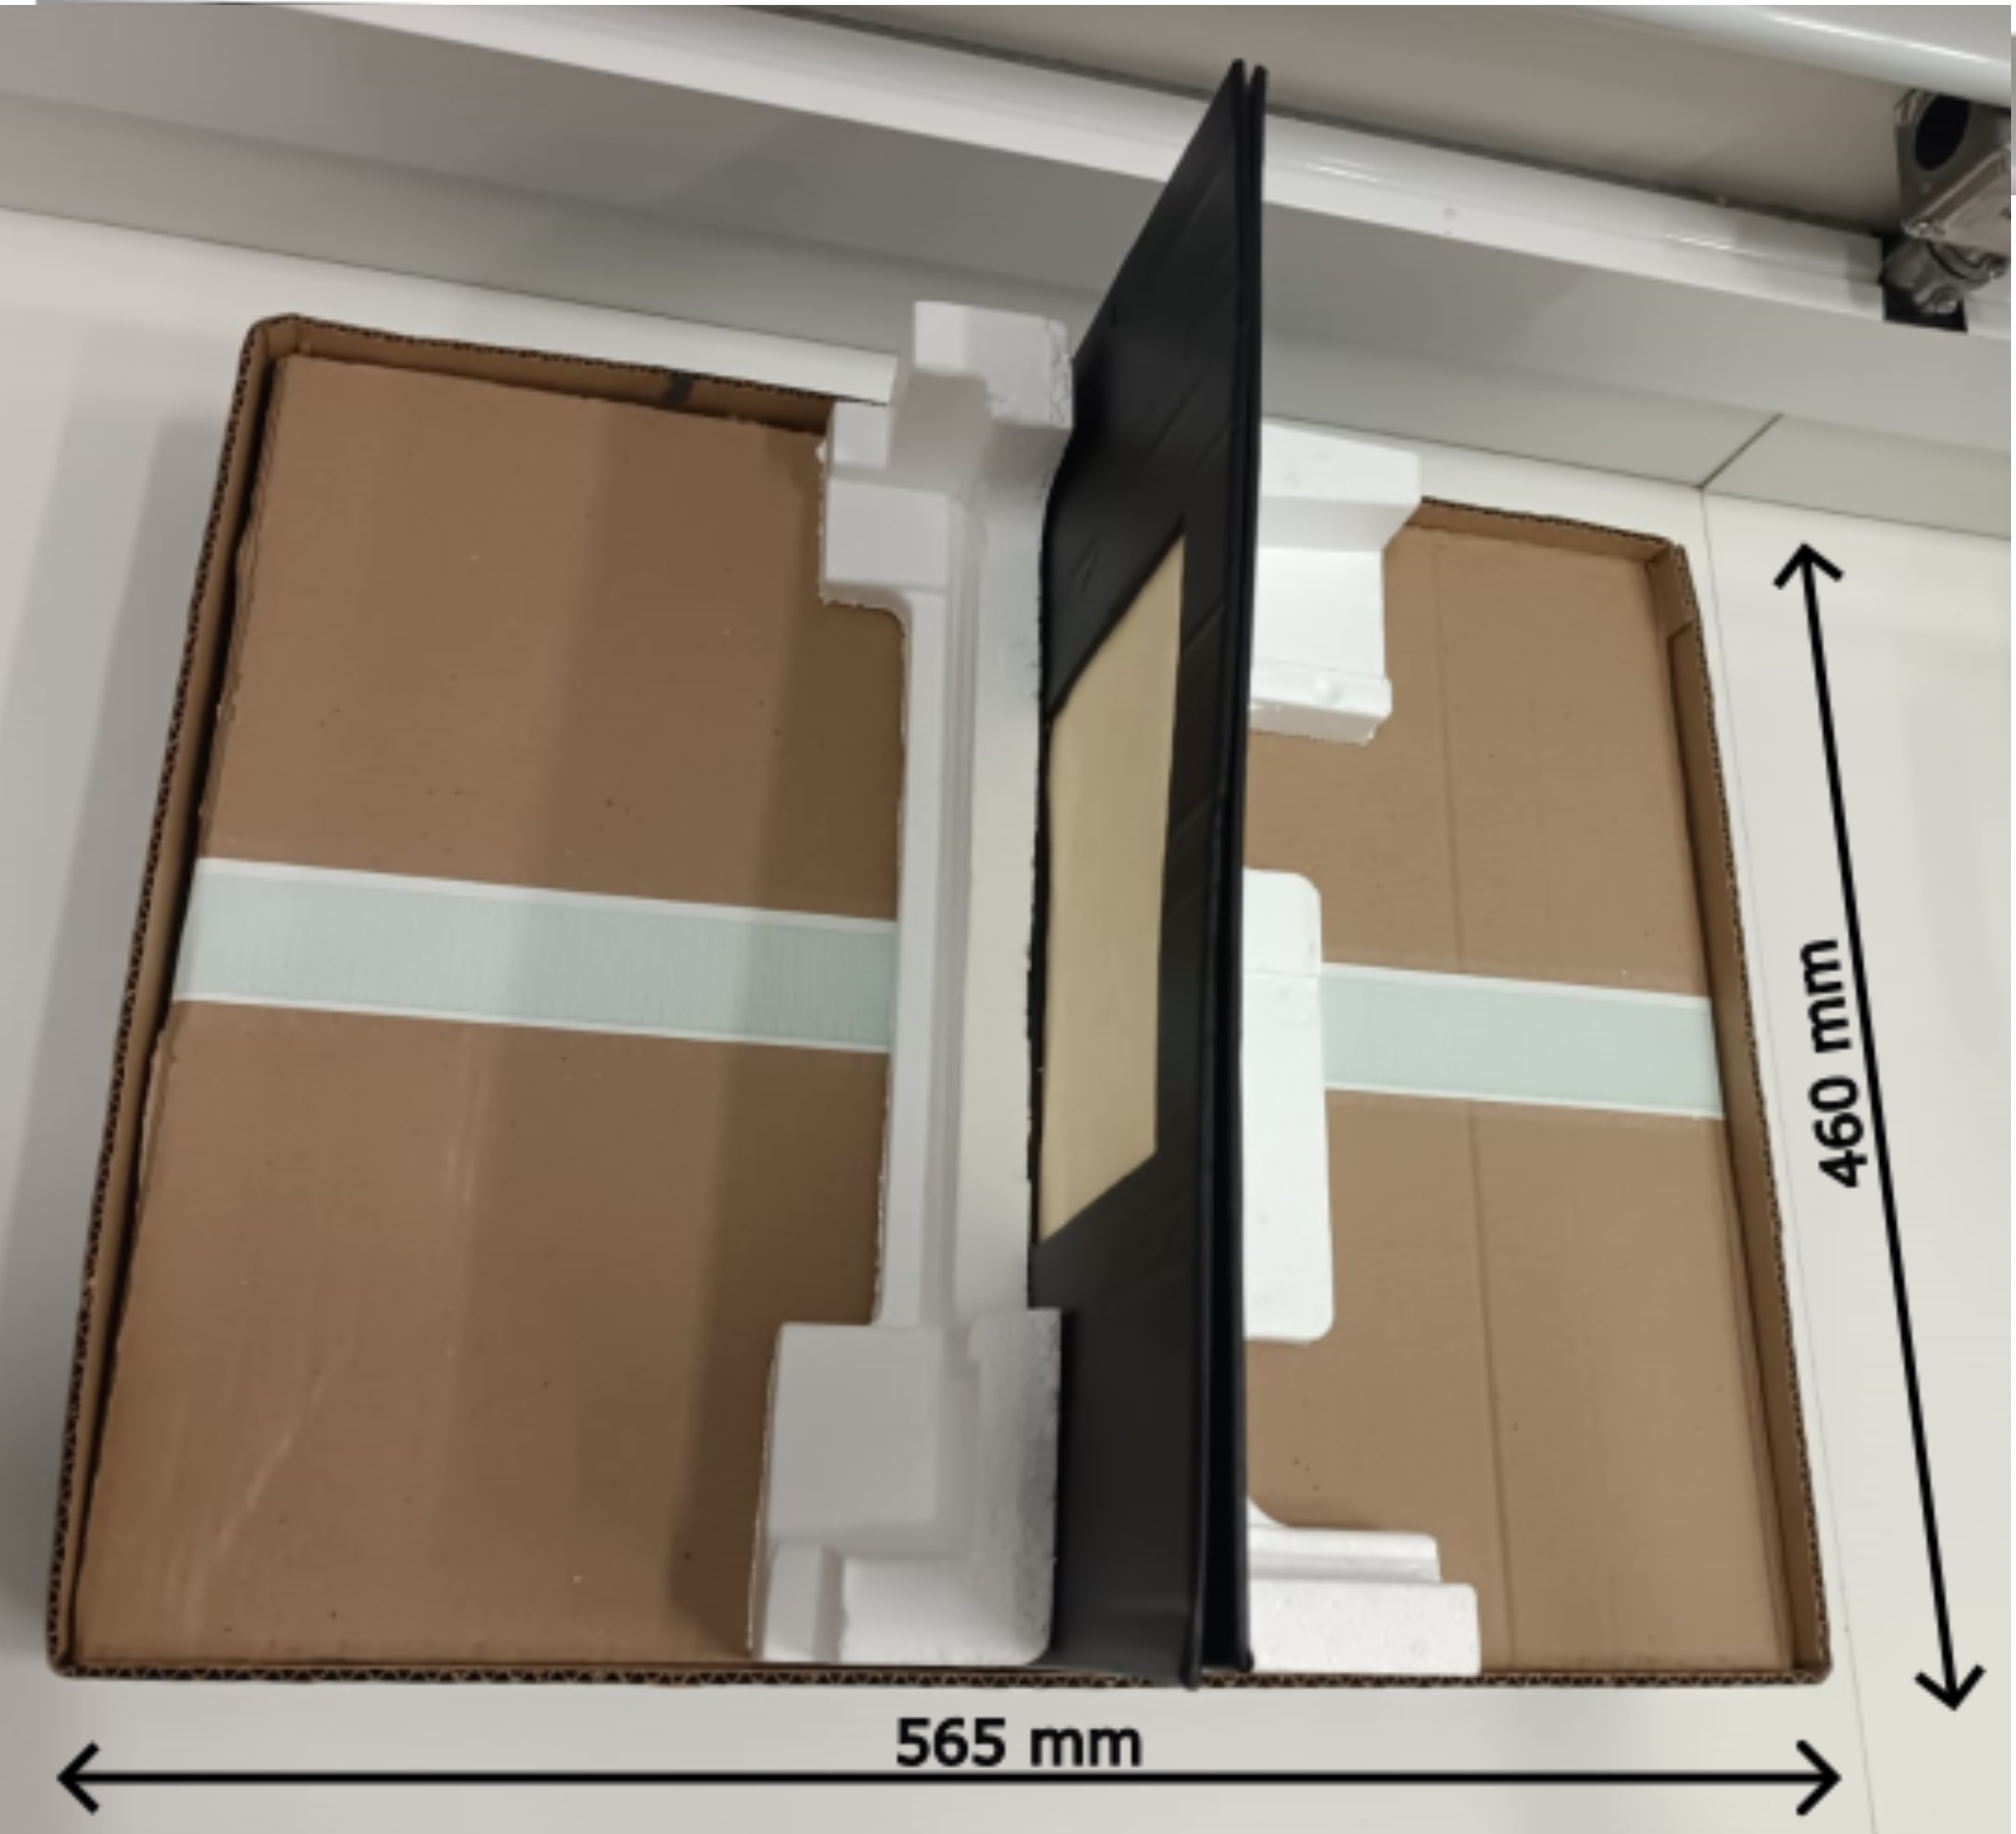
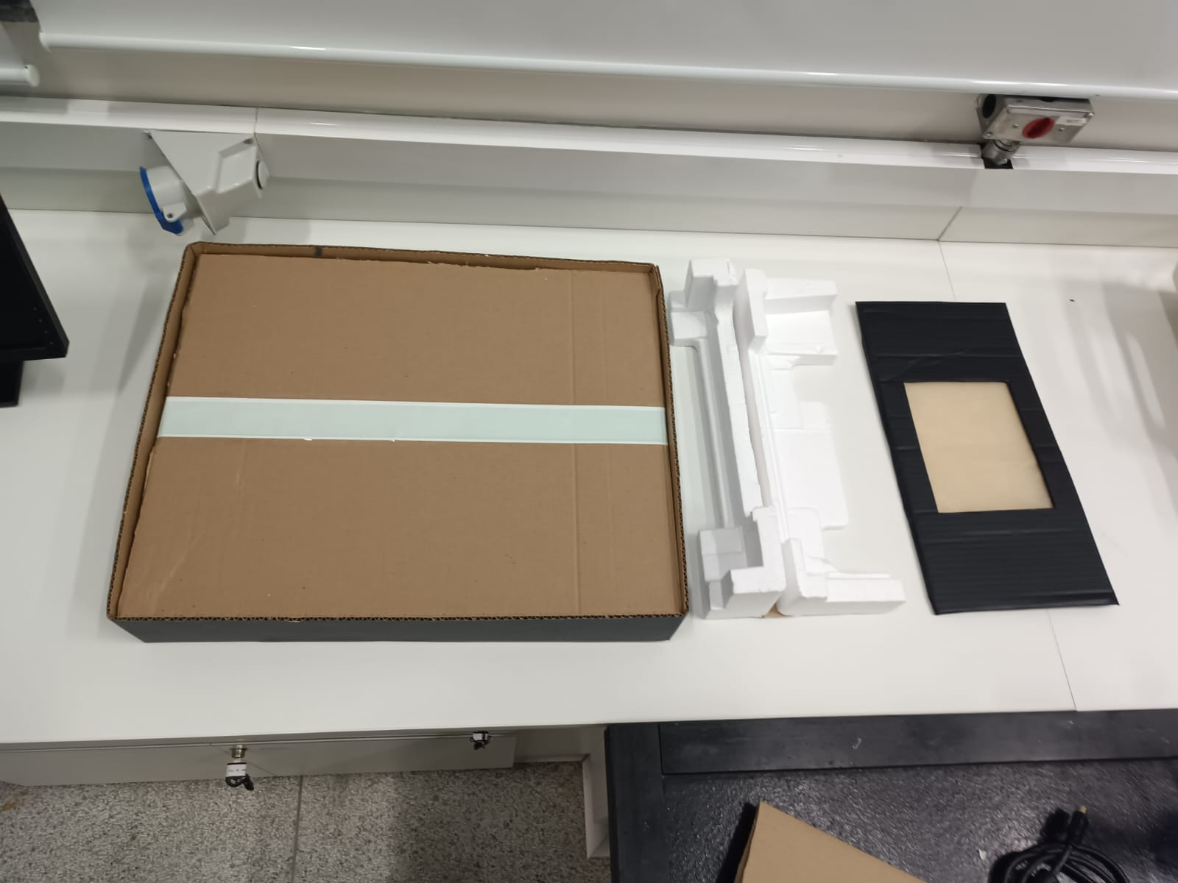
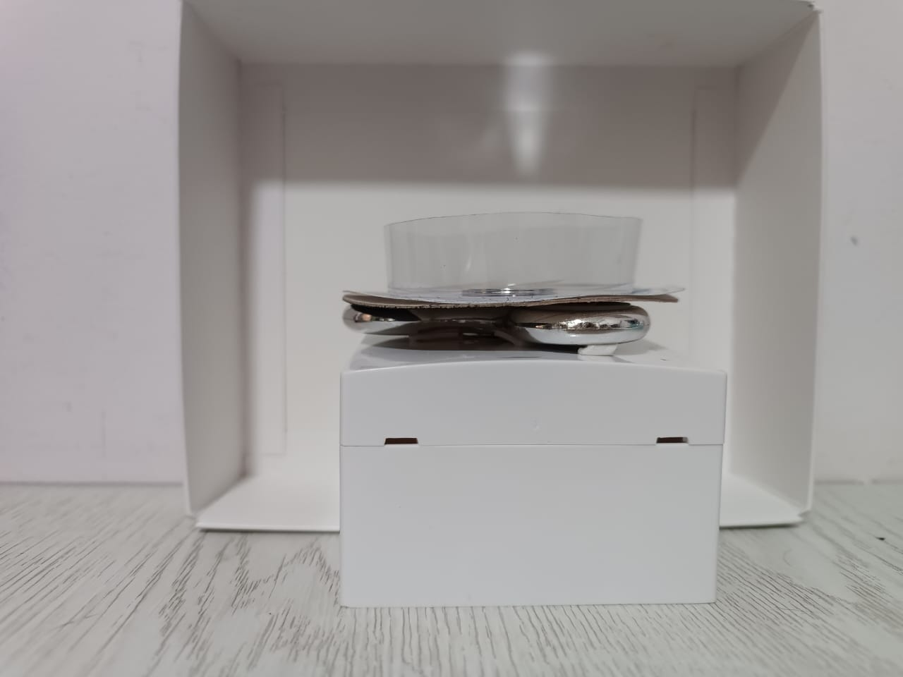
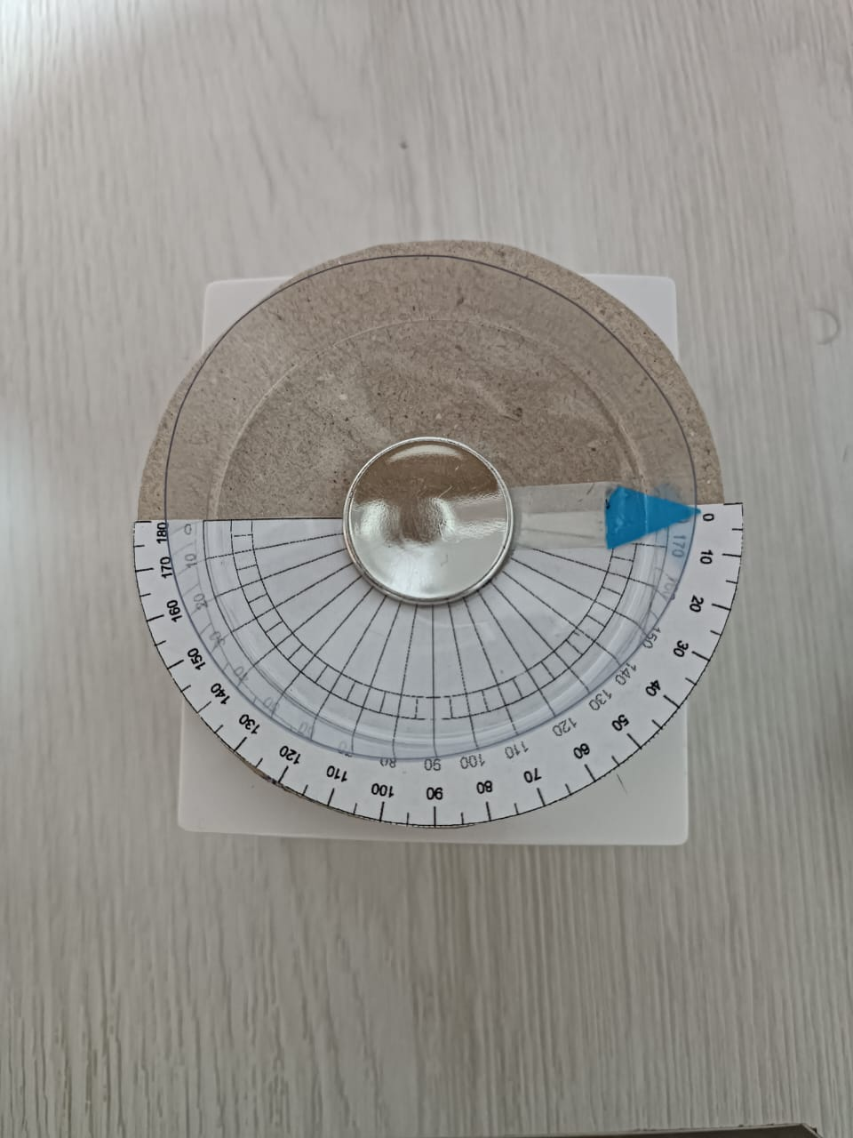
Equipment setup
Base
Screen
Support

Slide 8
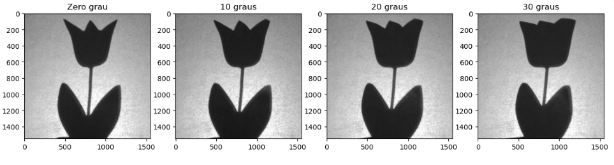
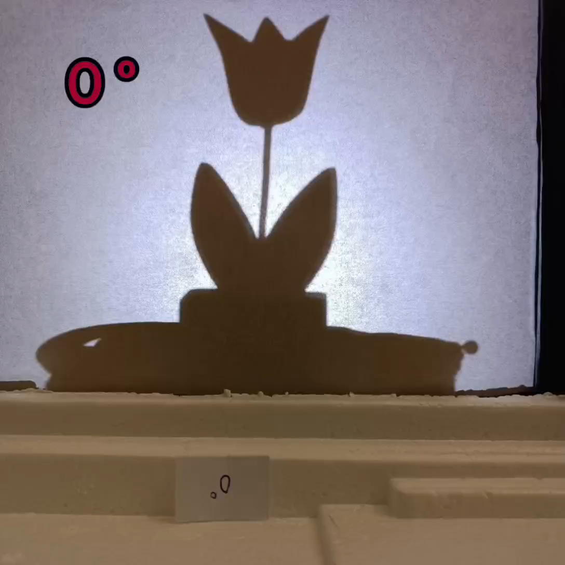
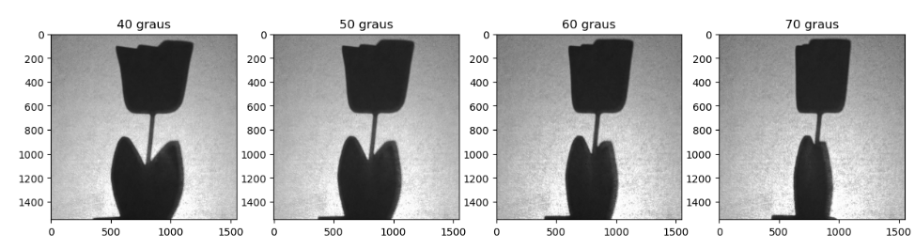
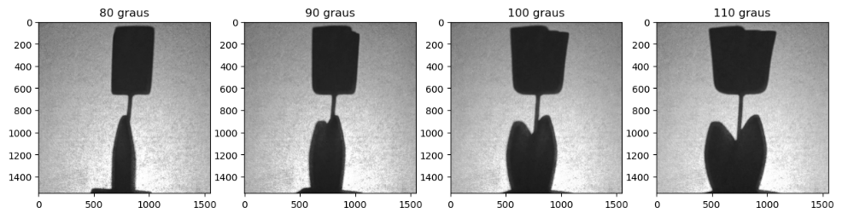
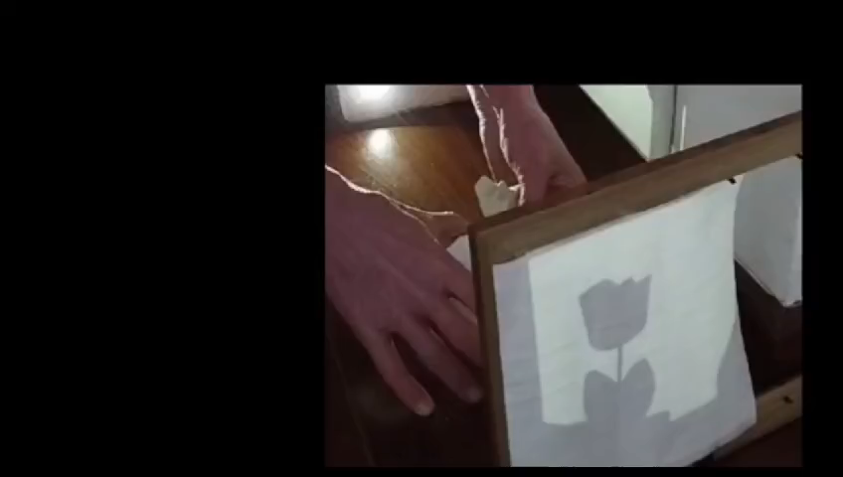
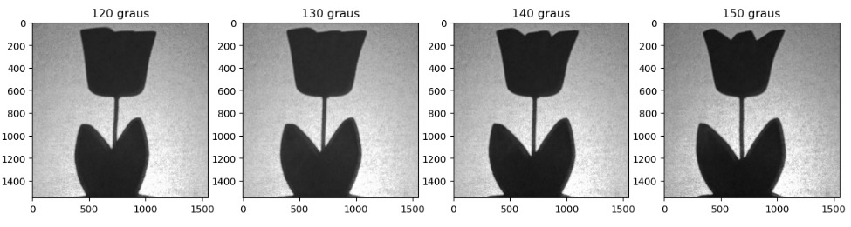
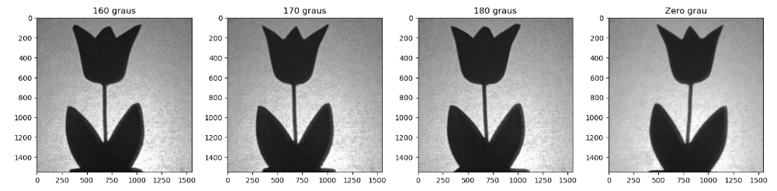
Image acquisition
Acquired by rotating the object through known angles
0º
to
180º

Slide 9
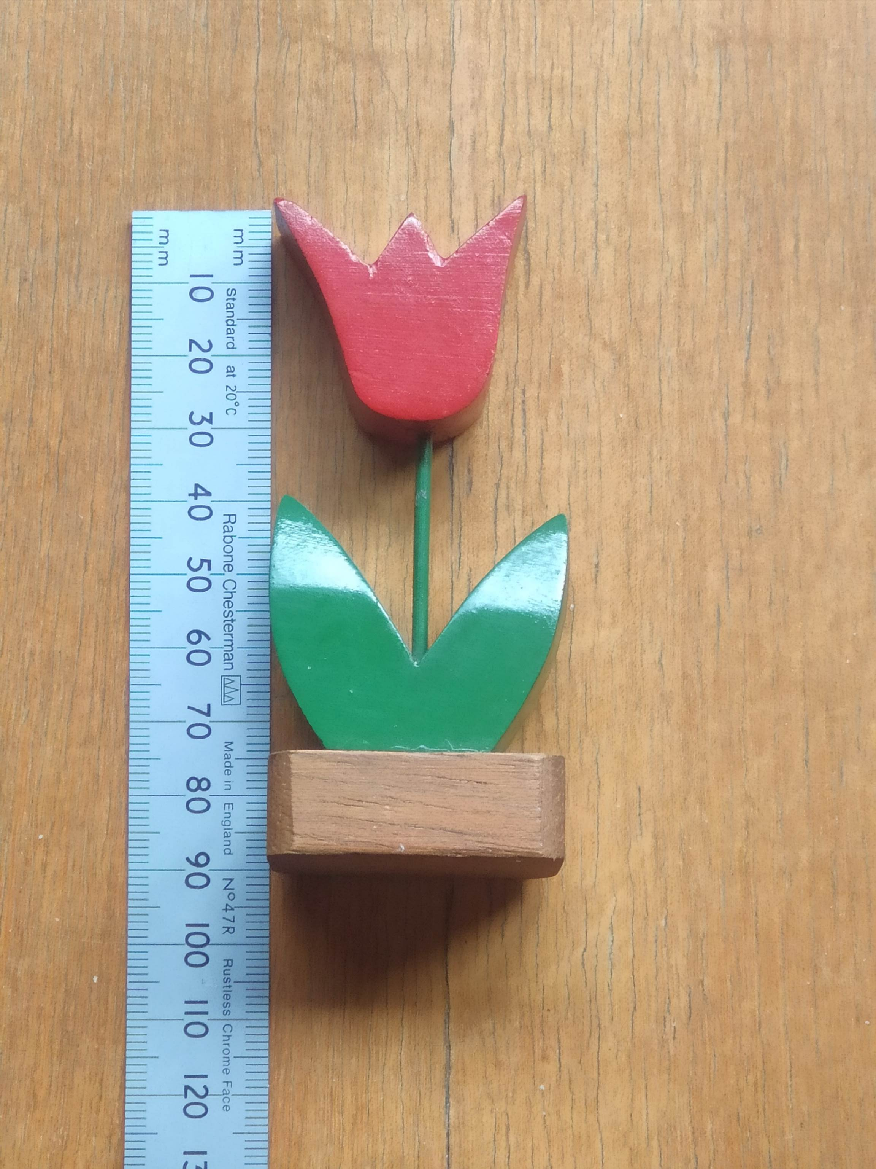
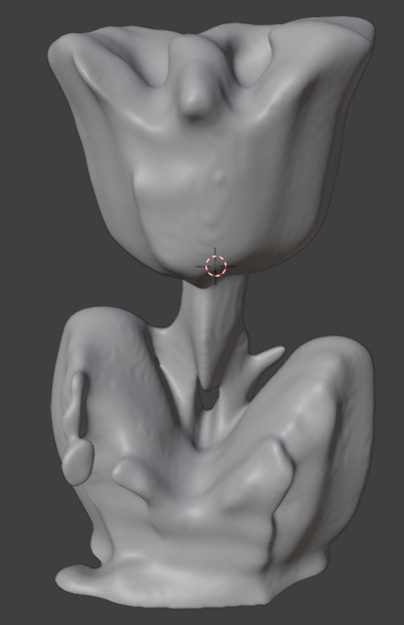
Results
and
Discussion

Slide 10
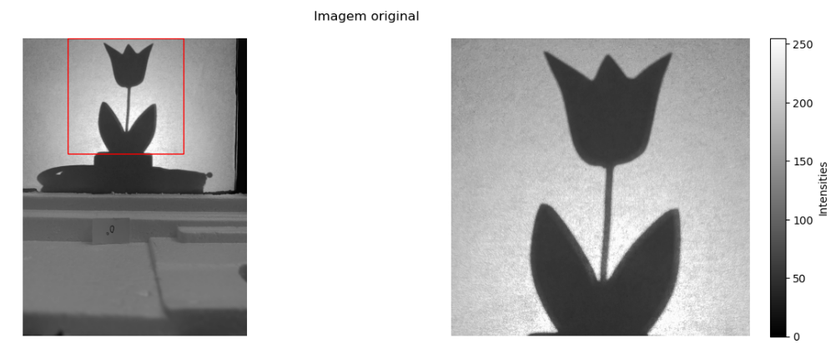
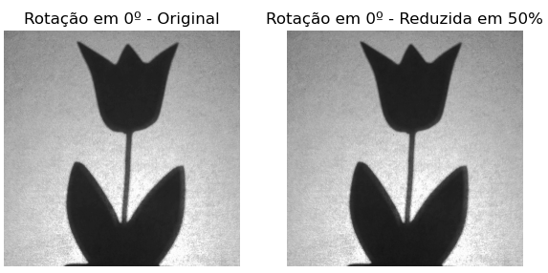
Preprocessing
Crop the image into a region of interest
Image reduction by 50%*
Original: 1.550 x 1.550 pixels
Reduced: 387 x 387 pixels
* Reducing machine space in ~88%

Slide 11
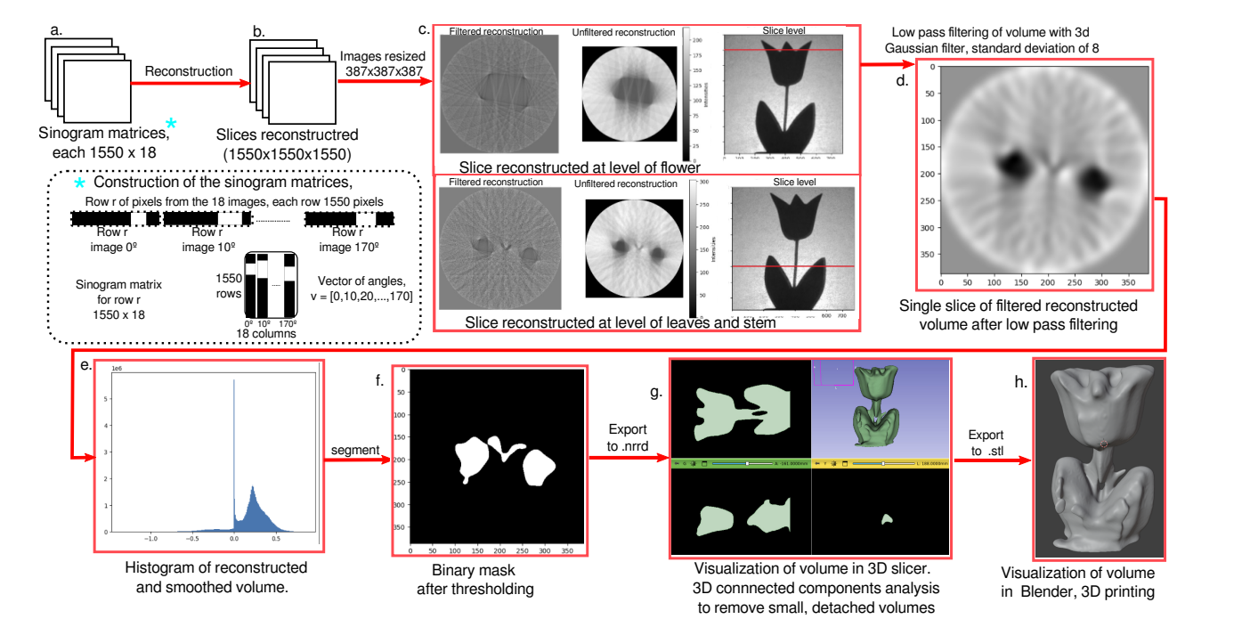
Tomographic reconstruction

Slide 12
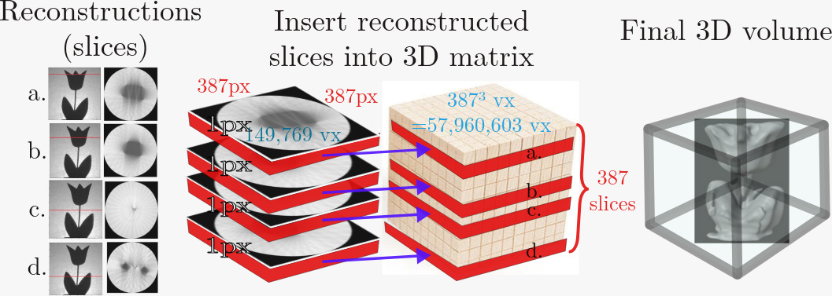
Tomographic reconstruction – 3D

Slide 13
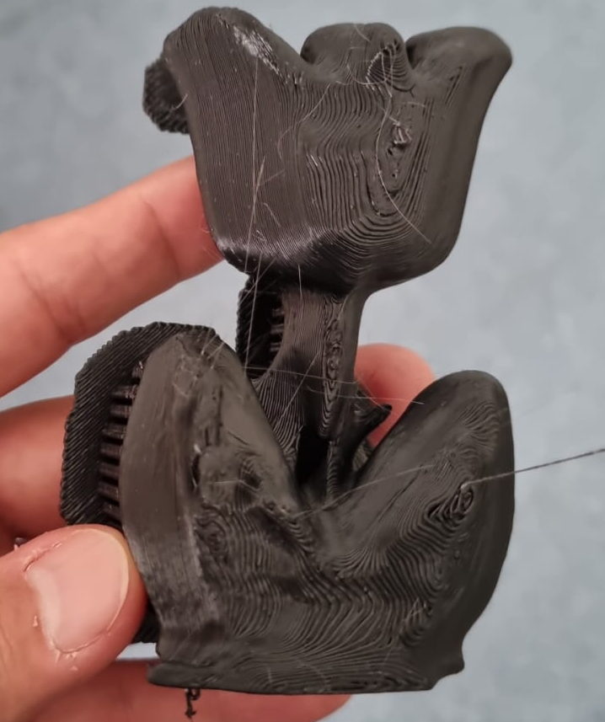
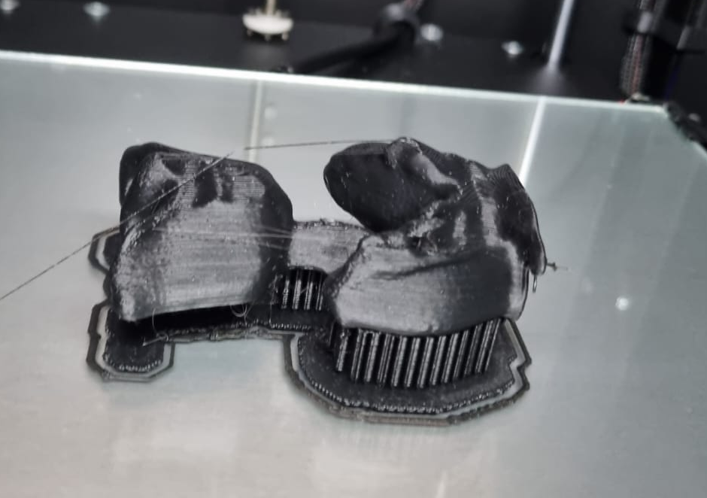
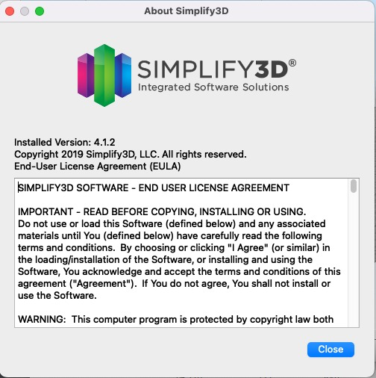
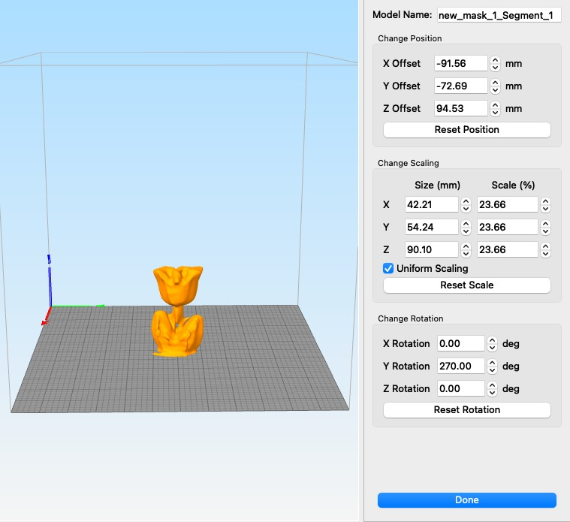
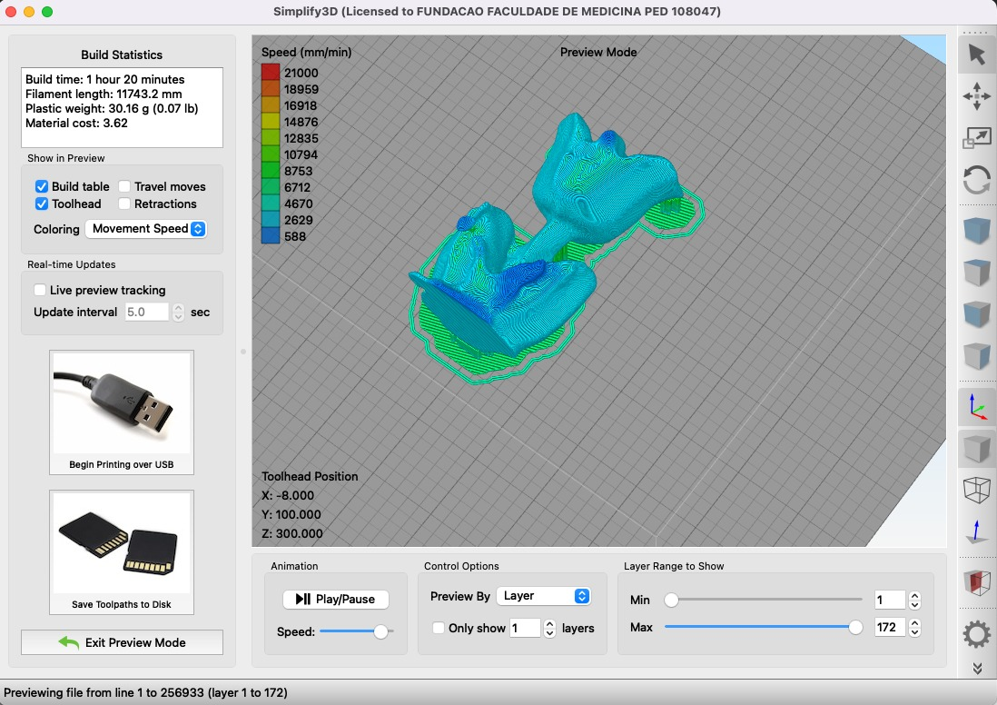
3D printing
The reconstructed object was 3D printed in collaboration with Dr. Khalil from the PISA (Platform for Imaging in the Autopsy Room) project - FM-USP (the 7T MRI)
Printer: 3D CORE A3 GTMAX3D - PRO
Material: ABS Plastic Filament

Slide 14
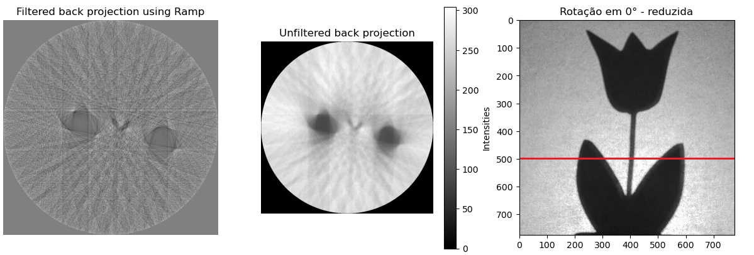
Limitations

Slide 15
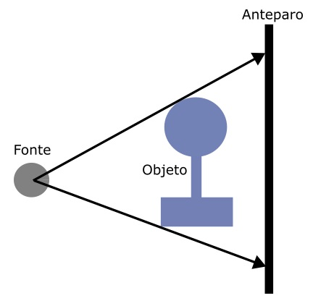
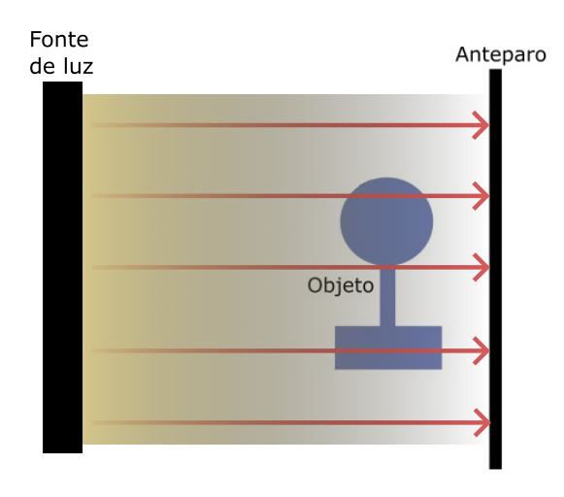

Limitations
Light source used: fan beam
Ideal source: in parallel beams

Slide 16

Conclusions
The research showed that there is room for improvement in CT teaching – a closer contact with teaching equipment would improve understanding of concepts.
The teaching equipment was built with accessible materials, ensuring easy reproducibility for teaching applications. Using visible light, it was possible to acquire images in multiple projections and obtain a 3D reconstruction similar to the initial object.
Software was developed to perform the tomographic reconstruction of the object in 3D with the acquired images. Some processing techniques were used such as low-pass filters, segmentation by threshold and removal of volume artifacts not connected to the main object.

Slide 17





Future steps
Automation: use Raspberry Pi (RPi) to control the rotation angle, as well as create a Wi-Fi link between the RPi and a notebook.
Software: make the tomographic reconstruction process more transparent
Collimation of the light source: acquisition of nearly parallel rays
Testing on other Phantoms: in the project we used an opaque object, it would be interesting to test on objects that project a partial shadow on the screen
Ex: opaque plastic or glass.
As classroom use becomes more common, several other applications and challenges can be created

Slide 18
References
BARBOSA, E. F.; MOURA, D. d. Metodologias ativas de aprendizagem no ensino de engenharia. In: Anais International Conference on Engineering and Technology Education, Cairo, Egito. [S.l.: s.n.], 2014. v. 13, p. 110–116
Emanuel Larsson, Doğa Gürsoy, Stephen A. Hall, Kitchen-based light tomography - a DIY toolkit for advancing tomography - by and for the tomography community. Tomography of Materials and Structures. Volume 1 2023. ISSN 2949-673X. https://doi.org/10.1016/j.tmater.2022.100001.
CRTR-CONSELHO REGIONAL DE TÉCNICOS EM RADIOLOGIA DE SÃO PAULO. Tomografia computadorizada: Evolução marcada por gerações. Disponível em <https://crtrsp.org.br/tomografia-computadorizada/> Acesso em 21 de abril de 2024.

Slide 19

OBRIGADO PELA
SUA ATENÇÃO!

